Slide 1
Measuring Internal Product Attributes: Structure
SE-843: Software Metrics

Slide 2
ASPECTS OF STRUCTURAL MEASURES
A software module or design can be viewed from several perspectives. The perspective that we use depends on:
1. The level of abstraction—program unit (function, method, class), package, subsystem, and system
2. The way the module or design is described—syntax and semantics
3. The specific attribute to be measured
We can think of structure from at least two perspectives:
1. Control flow structure
2. Data flow structure

Slide 3
Structural Complexity Properties
The relevant notion of complexity captures the complicatedness of the connections between elements in a system model. Here, complexity refers to the complexity of a system. The complexity of a system depends on the number of links between elements, and should, at a minimum satisfy the following properties:
Nonnegativity: System complexity cannot be negative
Null value: The complexity of a system with no links is zero.
Symmetry: The com
Module monotonicity: System complexity “is no less than the sum of the complexities of any two of its modules with no relationships in common.”
Disjoint module additively: The complexity of a system of disjoint modules is the sum of the complexities of the modules.

Slide 4
Length Properties
Sometimes, we are only interested in the size of an entity in terms of one dimension of a model. For example, we are only interested in a person’s height to predict whether or not a person would bump his or her head when entering a doorway. For software entities, we might be interested in the distance in terms of links from one element to another.

Slide 5
CONTROL FLOW STRUCTURE OF PROGRAM UNITS
A great deal of early software metrics work was devoted to measuring the control flow structure of individual functions, procedures, or methods implemented as imperative language programs or algorithms.
This work is still relevant, especially when applied to problems in software testing.
The control flow measures are usually modeled with directed graphs, where each node (or point) corresponds to a program statement or basic block (code that always executes sequentially), and each arc (or directed edge) indicates the flow of control from one statement or basic block to another.
We call these directed graphs control flowgraphs or flowgraphs.

Slide 6
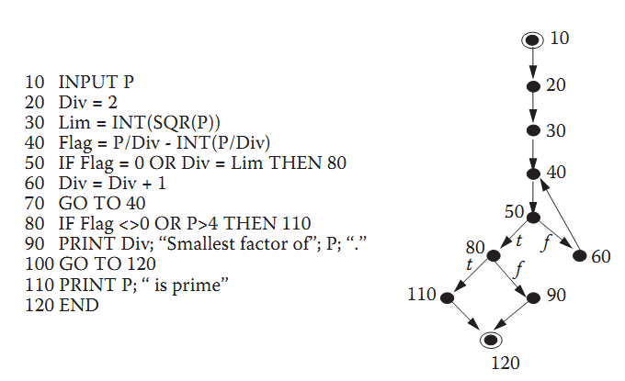
CONTROL FLOW STRUCTURE OF PROGRAM UNITS
FIGURE 9.1 A program and its corresponding flowgraph.

Slide 7
Flowgraph Model and the Notion of Structured Programs
We begin our discussion by reviewing graph-related terminology. Recall that a graph consists of a set of points (or nodes) and line segments (or edges). In a directed graph, each edge is assigned a direction, indicated by an arrowhead on the edge. This directed edge is called an arc.
Thus, directed graphs are depicted with a set of nodes, and each arc connects a pair of nodes. We write an arc as an ordered pair, <x, y>, where x and y are the nodes forming the endpoints of the arc, and the arrow indicates that the arc direction is from x to y.

Slide 8
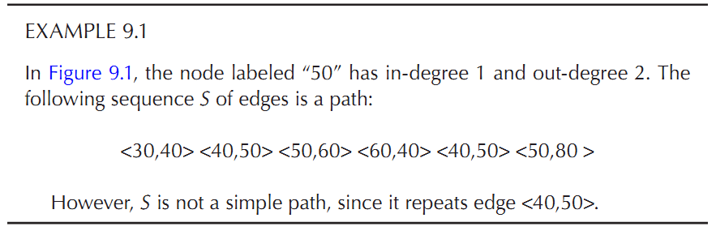
Path
A path* is a sequence of consecutive (directed) edges, some of which may be traversed more than once during the sequence. A simple path† is one in which there are no repeated edges.

Slide 9
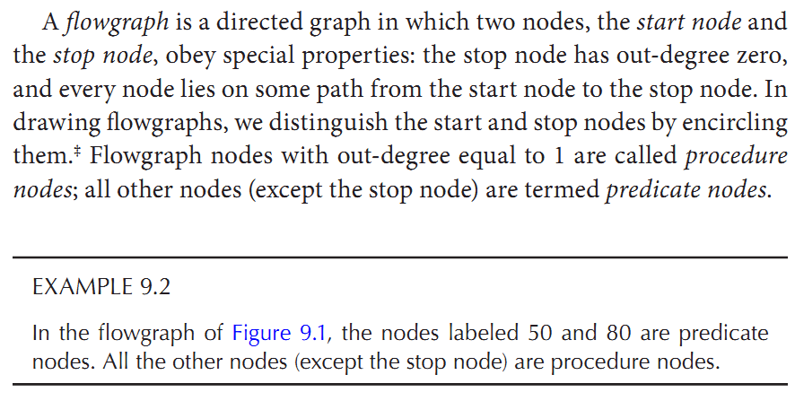
Graph node

Slide 10
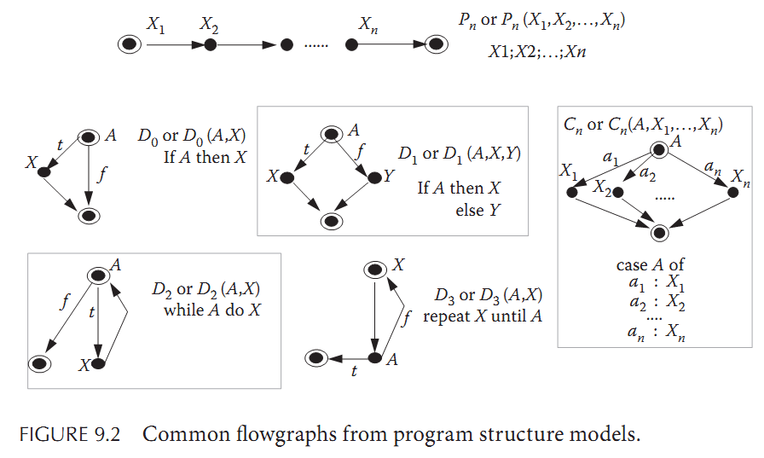
Flow graph

Slide 11
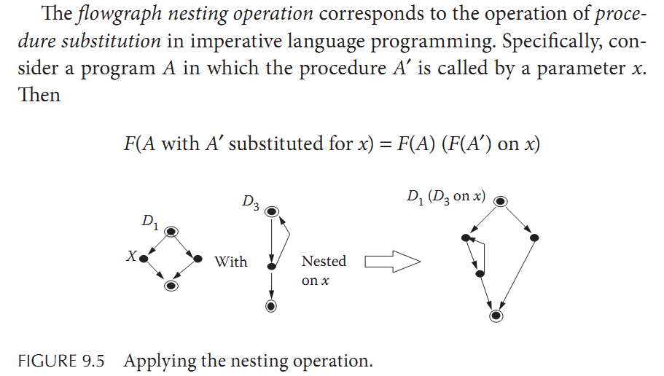
flowgraph nesting operation

Slide 12
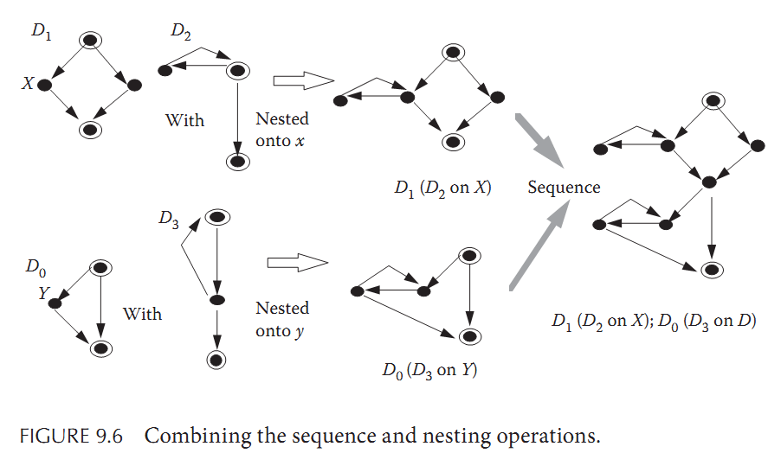

Slide 13
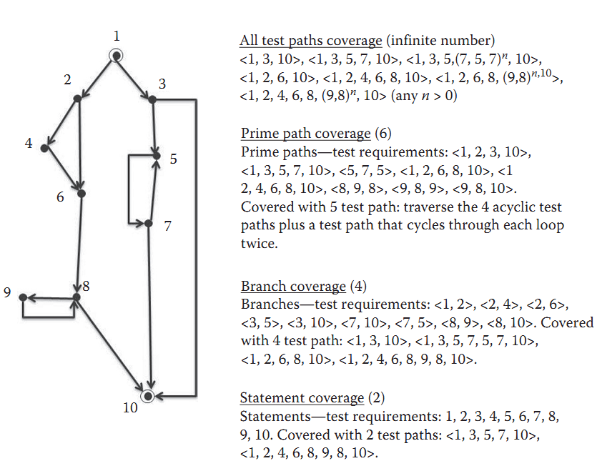
Minimum Number of Test Cases

Slide 14
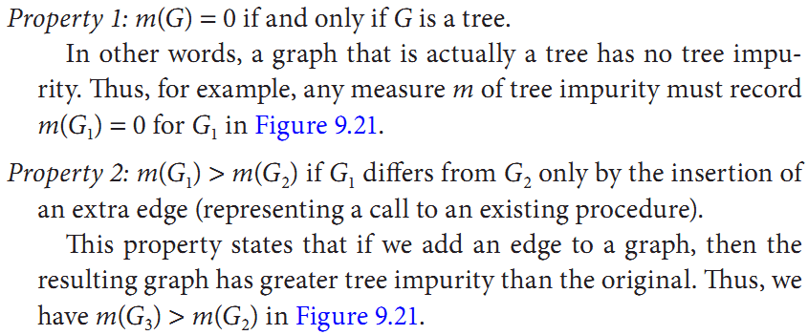
Graph

Slide 15
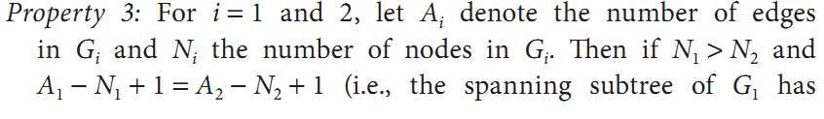
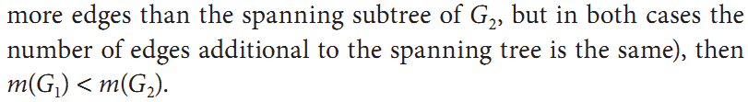
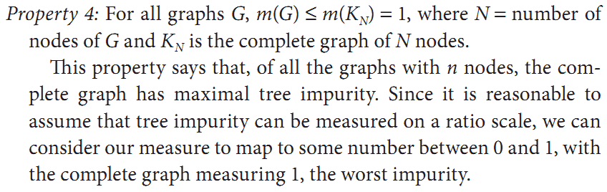
Graph

Slide 16
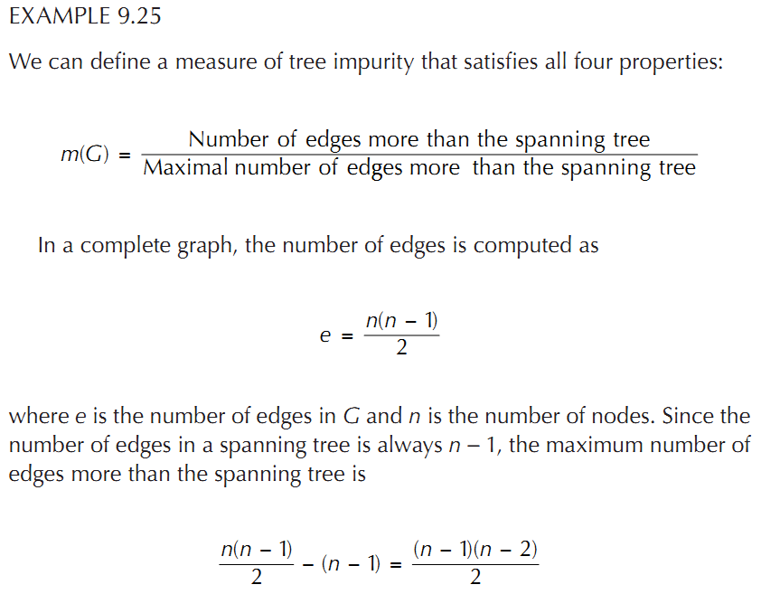
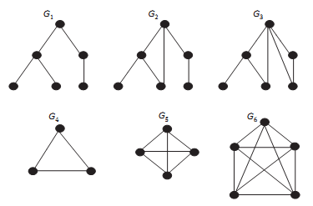
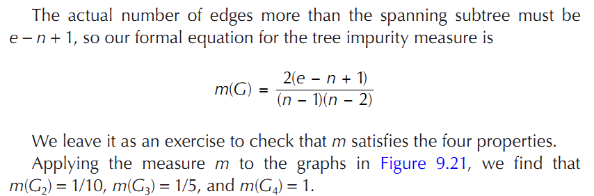
Graph

Slide 17
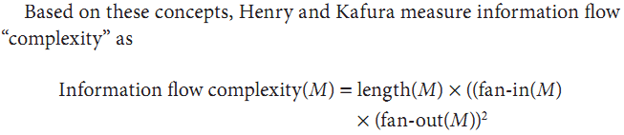
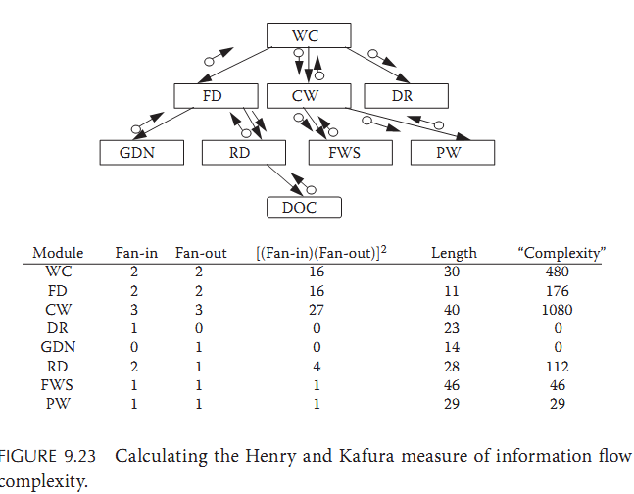
Information Flow

Slide 18
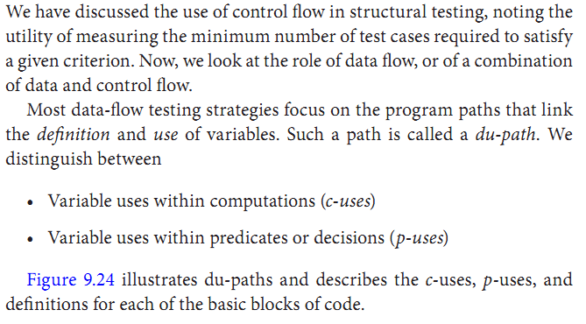
Information Flow: Test Coverage Measures

Slide 19
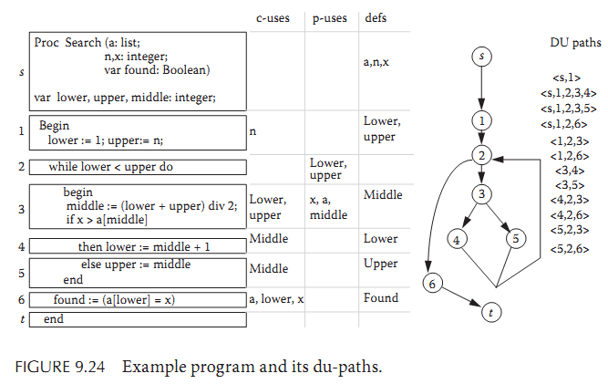
Information Flow: Test Coverage Measures

Slide 20
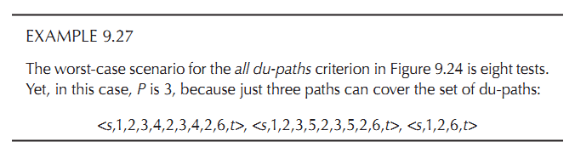

Slide 21
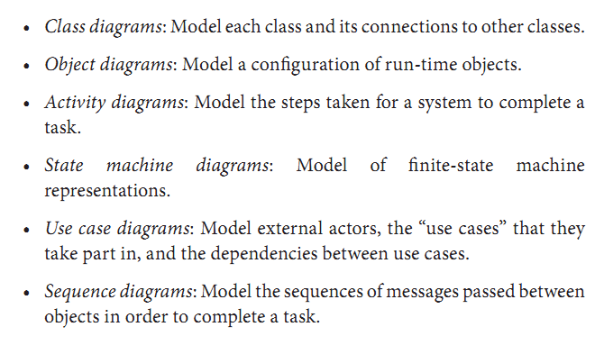
OBJECT-ORIENTED STRUCTURAL ATTRIBUTES AND MEASURES

